Slide 1
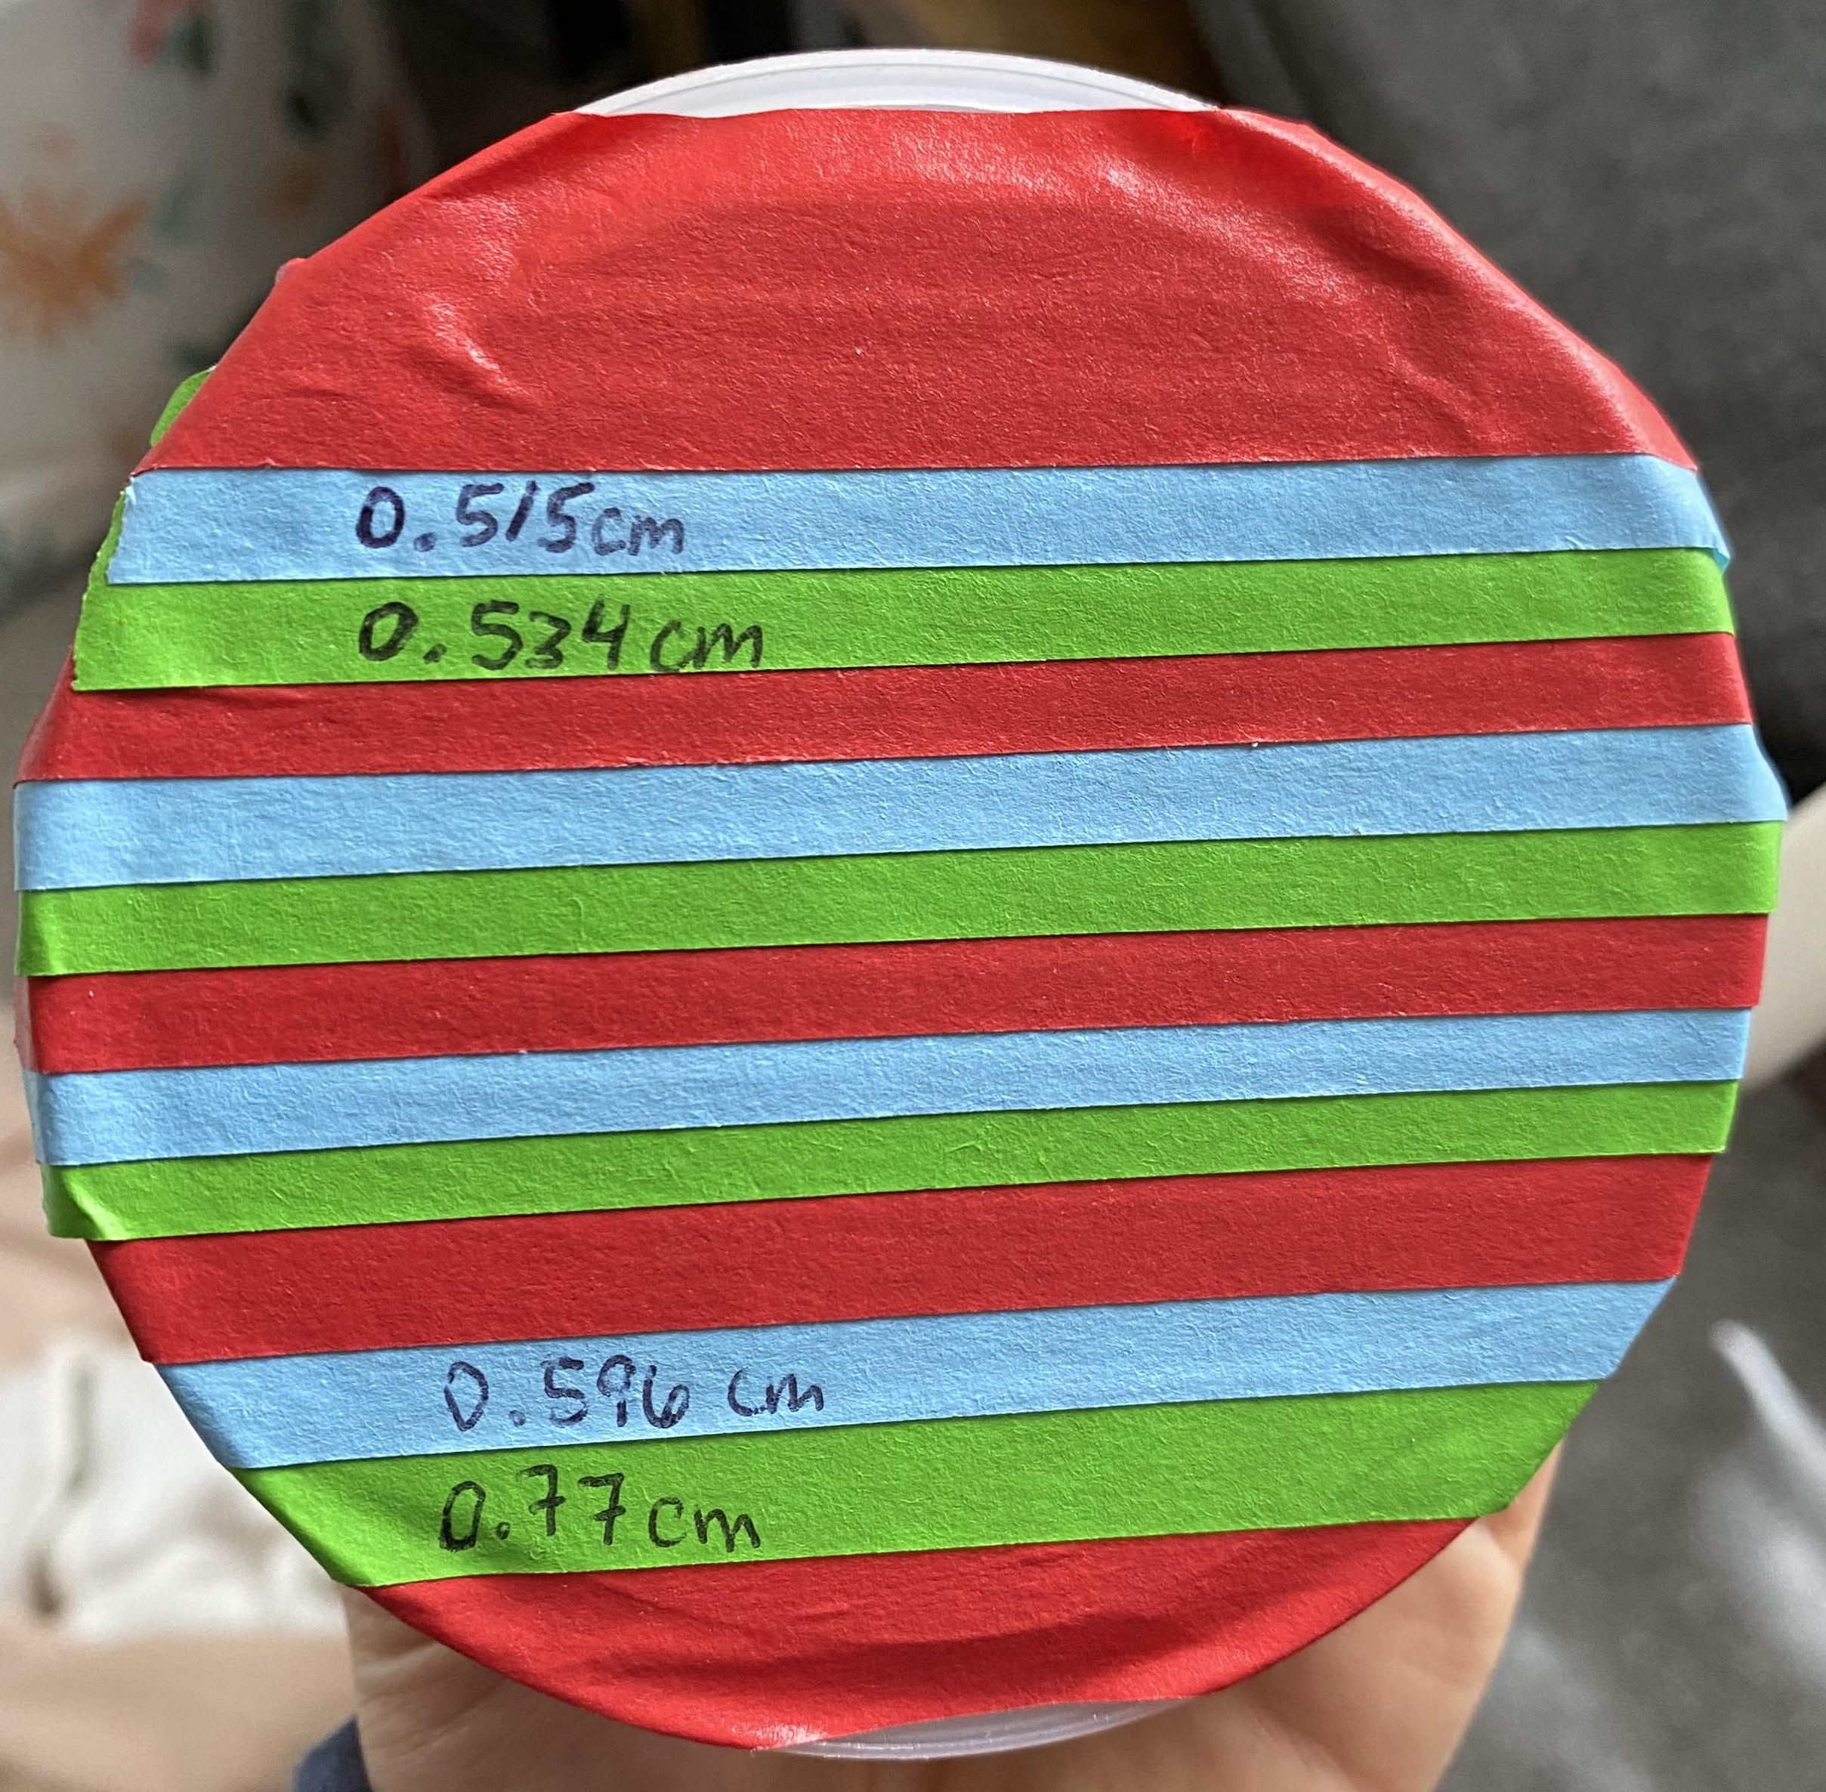
Standards were taken by taking the average of 10 measurement observations from various locations on the stripe and averaging them
0.5485 cm
blue_1
0.5122
green_1
red_1
0.4926
0.5403
blue_2
0.4834
green_2
0.5269
red_2
0.4454
blue_3
green_3
0.414
red_3
0.6995
blue_4
0.5771
green_4
0.7224

